Slide 1






Mohammed Khlifi
Presentation
Stock price prediction using Lstm network's
2024

Slide 2
Introduction
In the ever-evolving landscape of financial markets, the ability to predict stock prices accurately remains a formidable challenge. As we embark on this presentation, our primary focus is to address the pivotal question:
"How can we leverage advanced machine learning techniques, specifically Long Short-Term Memory models, to enhance the precision and reliability of stock price predictions in the face of market volatility and dynamic economic conditions?"

Slide 3
Overview
How to ...
Preprocess
Train
Predict
Evaluate
The data ?
The model ?
it on new data ?
Preformence ?

Slide 4
Preprocessing
Feature selection
Preprocessing
Normalizing Data
Reshaping Data

Slide 5
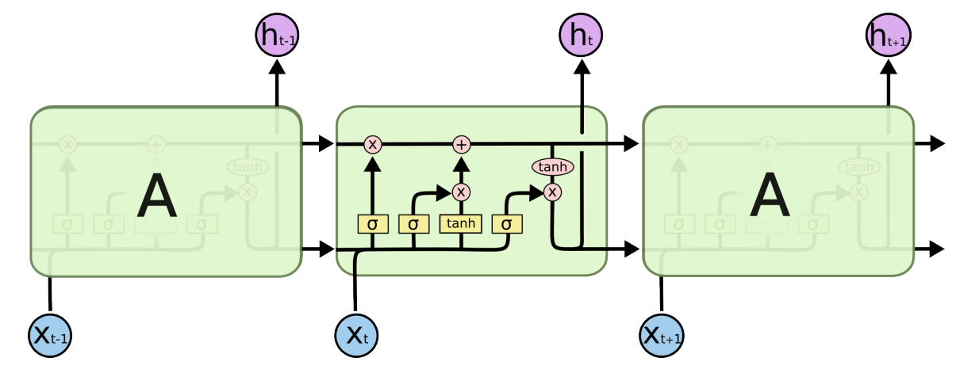
Long Short Term Memory
Memory Cells : can maintain information over long sequences,
mitigating the vanishing gradient problem

Slide 6

Gates
Long Short Term Memory
1
Forget Gate: Determines what information from the previous state should be discarded
Forget gate
Input Gate: Decides what new information to store in thememory cell
2
Input gate
Output Gate: Determines the information for output base don the current input and the memory cell’s state
3
Output gate

Slide 7
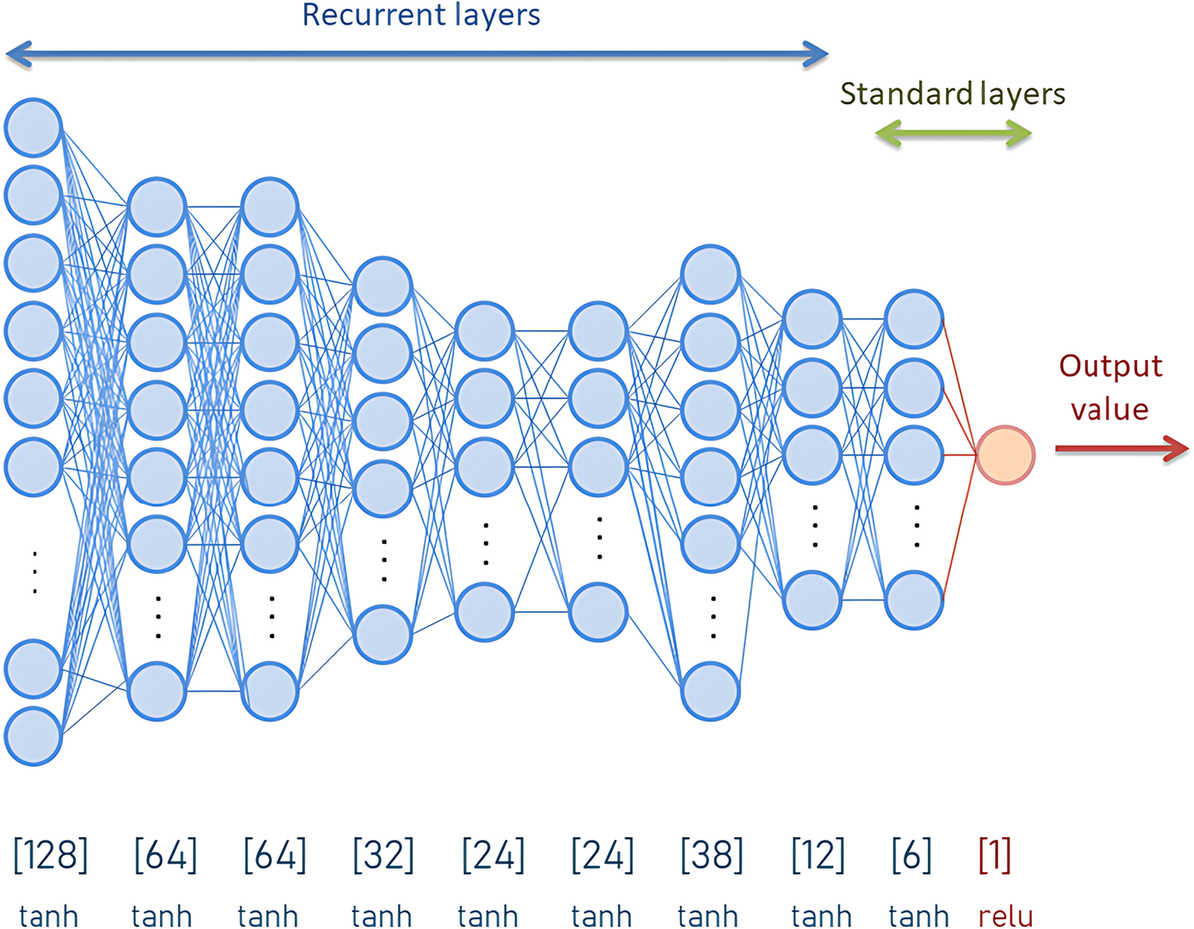
Model Desing
Model Training
Units =50
Drop rate =20%

Slide 8
Hyperparameters
Model Training
32
32
32
Epochs =32
A choice of 100 epochs and a batch size of 32 is a common configuration and often used as a starting point. However, these values can be influenced by various factors, including the size of your dataset, the complexity of the model, and the computational resources available.
Batch size = 100

Slide 9
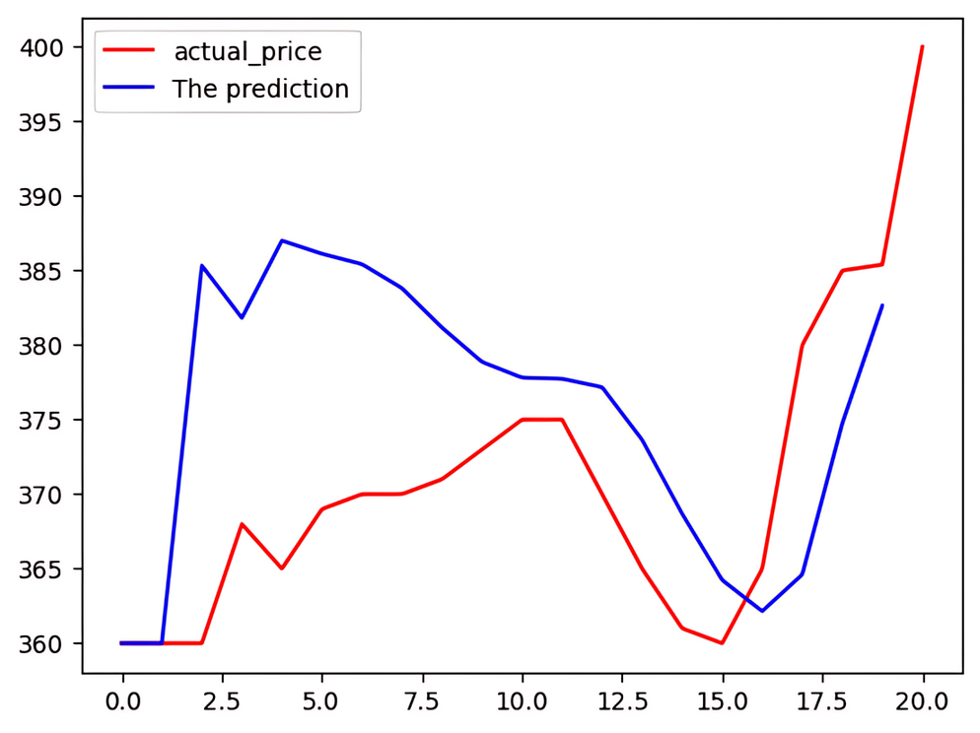
Results
Having laid the groundwork with the preceding analysis, our next objective is to forecast the initial month of January 2022. It’s note-worthy that we already possess the data for this month .

Slide 10
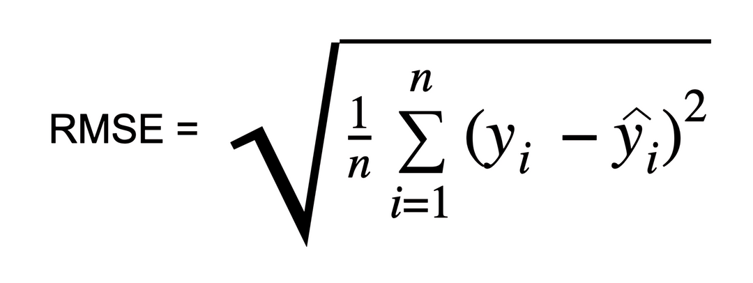
Evaluating
RSME : Root Mean Squared Error, is a commonly used metric for evaluating the performance of a regression model, such as the one used for predicting stock prices. It represents the square root of the average of the squared differences between the predicted and actual values.
n is the number of data points.
yi​ is the actual value for the i-th data point.
y​i​ is the predicted value for the i-th data point.
^
The RSME in our case is
RSME = 25.1996

Slide 11
Conclusion
In conclusion, this project exemplifies the power of LSTM networks in predicting stock prices. While achieving notable success with an RMSE of 25.20, it also underscores the challenges inherent in forecasting financial markets. As we navigate the complexities of stock price prediction, the journey continues with a commitment to refining models, exploring novel techniques, and adapting to the dynamic nature of financial markets.

Slide 12
@Mohammed Khlifi
Thank you for your attention

